Slide 1
CSE7302 -PROJECT Review-4 Presentation Transformer based end-to-end Web Application Firewall (WAF) pipeline
Batch Number: CDV_14 Roll Number | Student Name
20211CDV0062 20221CDV0050 20211CDV0024 | CHETHAS R VARSHITH R S ABDUL KALAM
Under the Supervision of,
Mrs. Aarfa khan
Assistant Professor
School of Computer Science and Engineering
Presidency University
Name of the Program: CDV-Computer Science & Technology (DEVOPS)
Name of the HoD: Dr. Pravinthraja S
Name of the Program Project Coordinator: Dr. H M Manjula
Name of the School Project Coordinator: Dr. Sampath A K , Dr. Geetha A

Slide 2
Content
About Company or Organization
Working domain or the technology
About your team and reporting Manager
Challenges Faced in Project
Objectives of the work
Literature Review
Proposed System
Problem Statement
System Requirements
Advantages of Proposed System/Work
System Design
System Implementation
System Testing
Conclusion
References
Github Link

Slide 3
About Company or Organization
The organization is a technology-driven company working in the field of software
development and cybersecurity.
It focuses on building secure, scalable, and reliable web applications and digital
solutions.
The company uses modern technologies such as cloud computing, machine
learning, and web security tools.
It promotes research-based development and practical implementation of
security solutions.
The work culture encourages learning, innovation, and teamwork to solve
real-world problems.

Slide 4
Working domain or the technology
Domain: Cybersecurity and Web Application Security
Core Focus: Web Application Firewall (WAF) using Deep Learning
Technologies Used:
Machine Learning & Deep Learning
Transformer Models (Attention-based Neural Networks)
Python Programming
HTTP/HTTPS Traffic Analysis
Basic Web Security Concepts (SQL Injection, XSS, etc.)
Purpose: To build an intelligent system that detects and blocks malicious
web requests in real time.

Slide 5
About your team and reporting Manager
Our team consisted of 3 members working together on the project.
The team was involved in design, development, and testing of the system.
We had guide who guided us throughout the internship.
The guide provided technical guidance, reviews, and feedback at each stage of the project.
Regular discussions and reviews helped us improve the quality and correctness of the work.
The team environment encouraged learning, teamwork, and practical
problem-solving.

Slide 6
Challenges Faced in Project
Understanding cybersecurity and Web Application Firewall (WAF) concepts initially
Learning and applying Transformer and deep learning models
Collecting and preprocessing HTTP request data for training
Limited availability of real-world labeled datasets
Debugging model performance and reducing false positives
Managing time between learning, development, and documentation

Slide 7
Objectives of the work
To study existing Web Application Firewall (WAF) techniques
To understand the use of Machine Learning and Transformer models in cybersecurity
To design an end-to-end WAF pipeline using deep learning
To detect common web attacks such as SQL Injection and XSS
To improve detection accuracy compared to traditional methods
To build a working prototype of the proposed system

Slide 8
Literature Review
Traditional Web Application Firewalls (WAFs) mainly use rule-based and
signature-based methods, which work well for known attacks but fail against
new and obfuscated attacks.
Machine Learning approaches were introduced to improve detection, but they
depend heavily on manual feature extraction and labeled data.
Recent research uses Deep Learning models such as CNNs, RNNs, and
Transformer models by treating HTTP requests as text sequences.
Transformer-based models are effective because they can capture contextual
and long-range dependencies in request data.
Studies show better detection accuracy using deep learning, but most works
focus only on offline experiments and not real deployment.

Slide 9
Research Gap
Lack of a complete end-to-end WAF pipeline using Transformers
Most studies do not consider real-time performance and latency
No standard dataset for evaluating Transformer-based WAF
systems
Limited work on handling obfuscated and adversarial attacks
Poor explain ability of model decisions for security analysts

Slide 10
Proposed Solutions
Design an end-to-end Transformer-based WAF pipeline from data
input to decision making
Use optimized and lightweight Transformer models for faster
real-time detection
Build or combine datasets with realistic normal and attack traffic
Apply data augmentation and adversarial training to improve
robustness
Add explain ability methods (highlight important parts of requests)
to help analysts understand alerts

Slide 11
Proposed System / Work
The proposed system is a Transformer-based end-to-end Web
Application Firewall (WAF).
It analyzes HTTP requests from web applications in real time.
Requests are preprocessed and tokenized before being given to the
model.
A Transformer deep learning model classifies each request as
normal or malicious.
Based on the prediction, the system allows or blocks the request.
All decisions are logged for monitoring and future improvement.

Slide 12
Problem Statement
Traditional Web Application Firewalls (WAFs) rely mainly on rule-based and
signature-based detection.
These methods are difficult to maintain and fail to detect new or
obfuscated attacks.
With the rapid growth of web applications, the number and complexity of
attacks are also increasing.
There is a need for an intelligent, automated, and adaptive system to
detect malicious web requests.
The problem is to design a Transformer-based WAF that can accurately and
efficiently detect attacks in real time.

Slide 13
System Requirements
Hardware Requirements:
Laptop / Desktop Computer
Minimum 8 GB RAM
Minimum 50 GB free storage
Internet connection
Software Requirements:
Operating System: Windows / Linux
Programming Language: Python
Libraries/Frameworks: PyTorch or TensorFlow, NumPy, Pandas
Development Tools: VS Code / PyCharm
Dataset: HTTP request dataset or sample web traffic logs

Slide 14
Advantages of Proposed System/Work
Detects both known and unknown web attacks
Reduces reliance on manual rules and signatures
Uses Transformer-based deep learning for better accuracy
Capable of handling obfuscated and complex attacks
Scalable and adaptable to new attack patterns
Can be integrated with existing web security systems

Slide 15
System Design
Design a Transformer-based End-to-End Web Application Firewall (WAF) that:
Inspects HTTP requests
Detects malicious traffic (SQLi, XSS, RCE, etc.)
Uses a Transformer model instead of rule-based matching
Works in real-time (low latency)
Scales horizontally

Slide 16
System Implementation
Collect HTTP request logs (normal + malicious).
Label data as 0 (Benign) and 1 (Malicious).
Convert HTTP requests into text format.
Use Transformer tokenizer (e.g., Distil BERT tokenizer).
Use a pre-trained model (Distil BERT/BERT).
Fine-tune on labeled WAF dataset.
Load trained model into FastAPI/Flask service.
If confidence > threshold → BLOCK request.
Else → ALLOW request.
System ready for scaling and production enhancement.

Slide 17
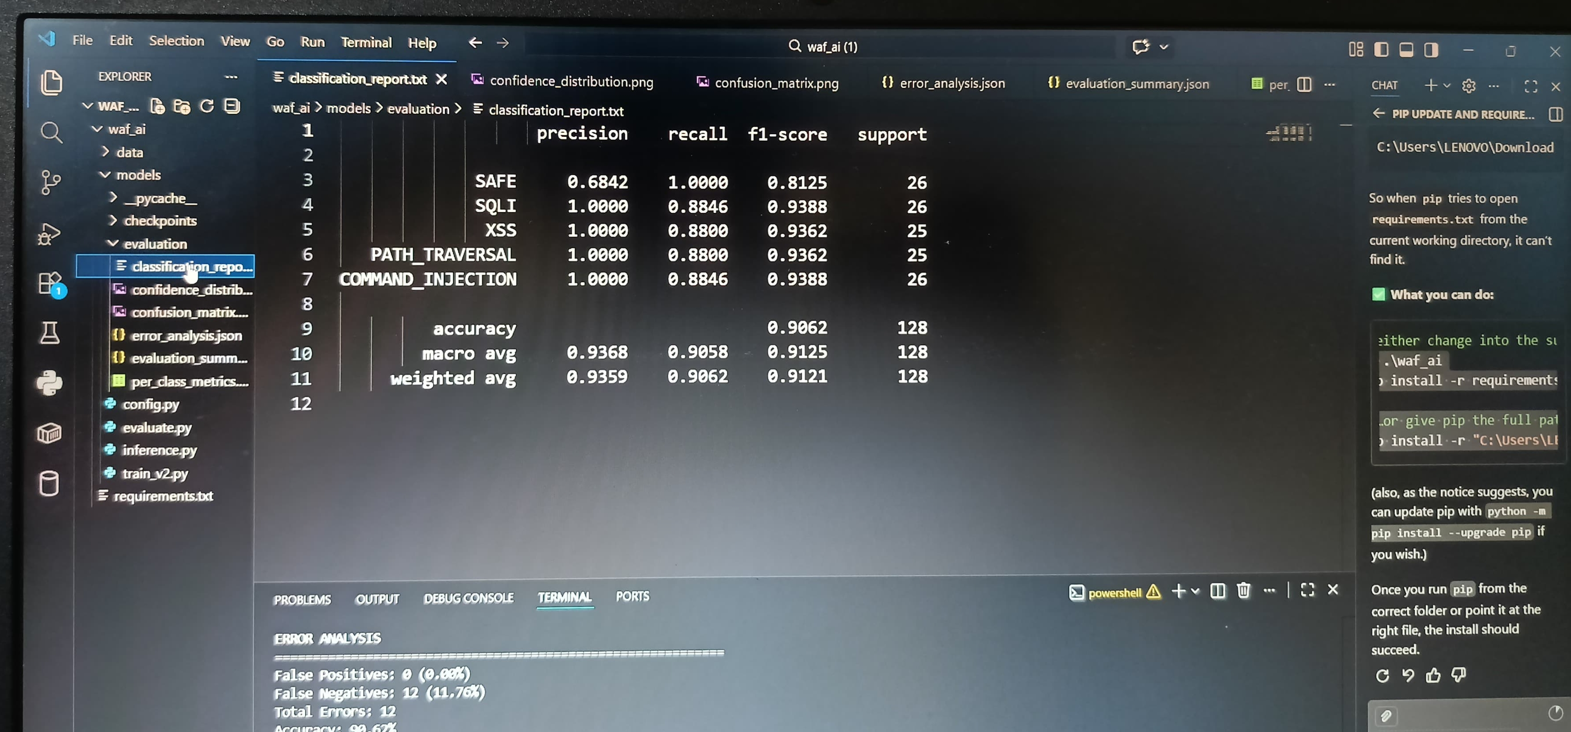
System Testing

Slide 18
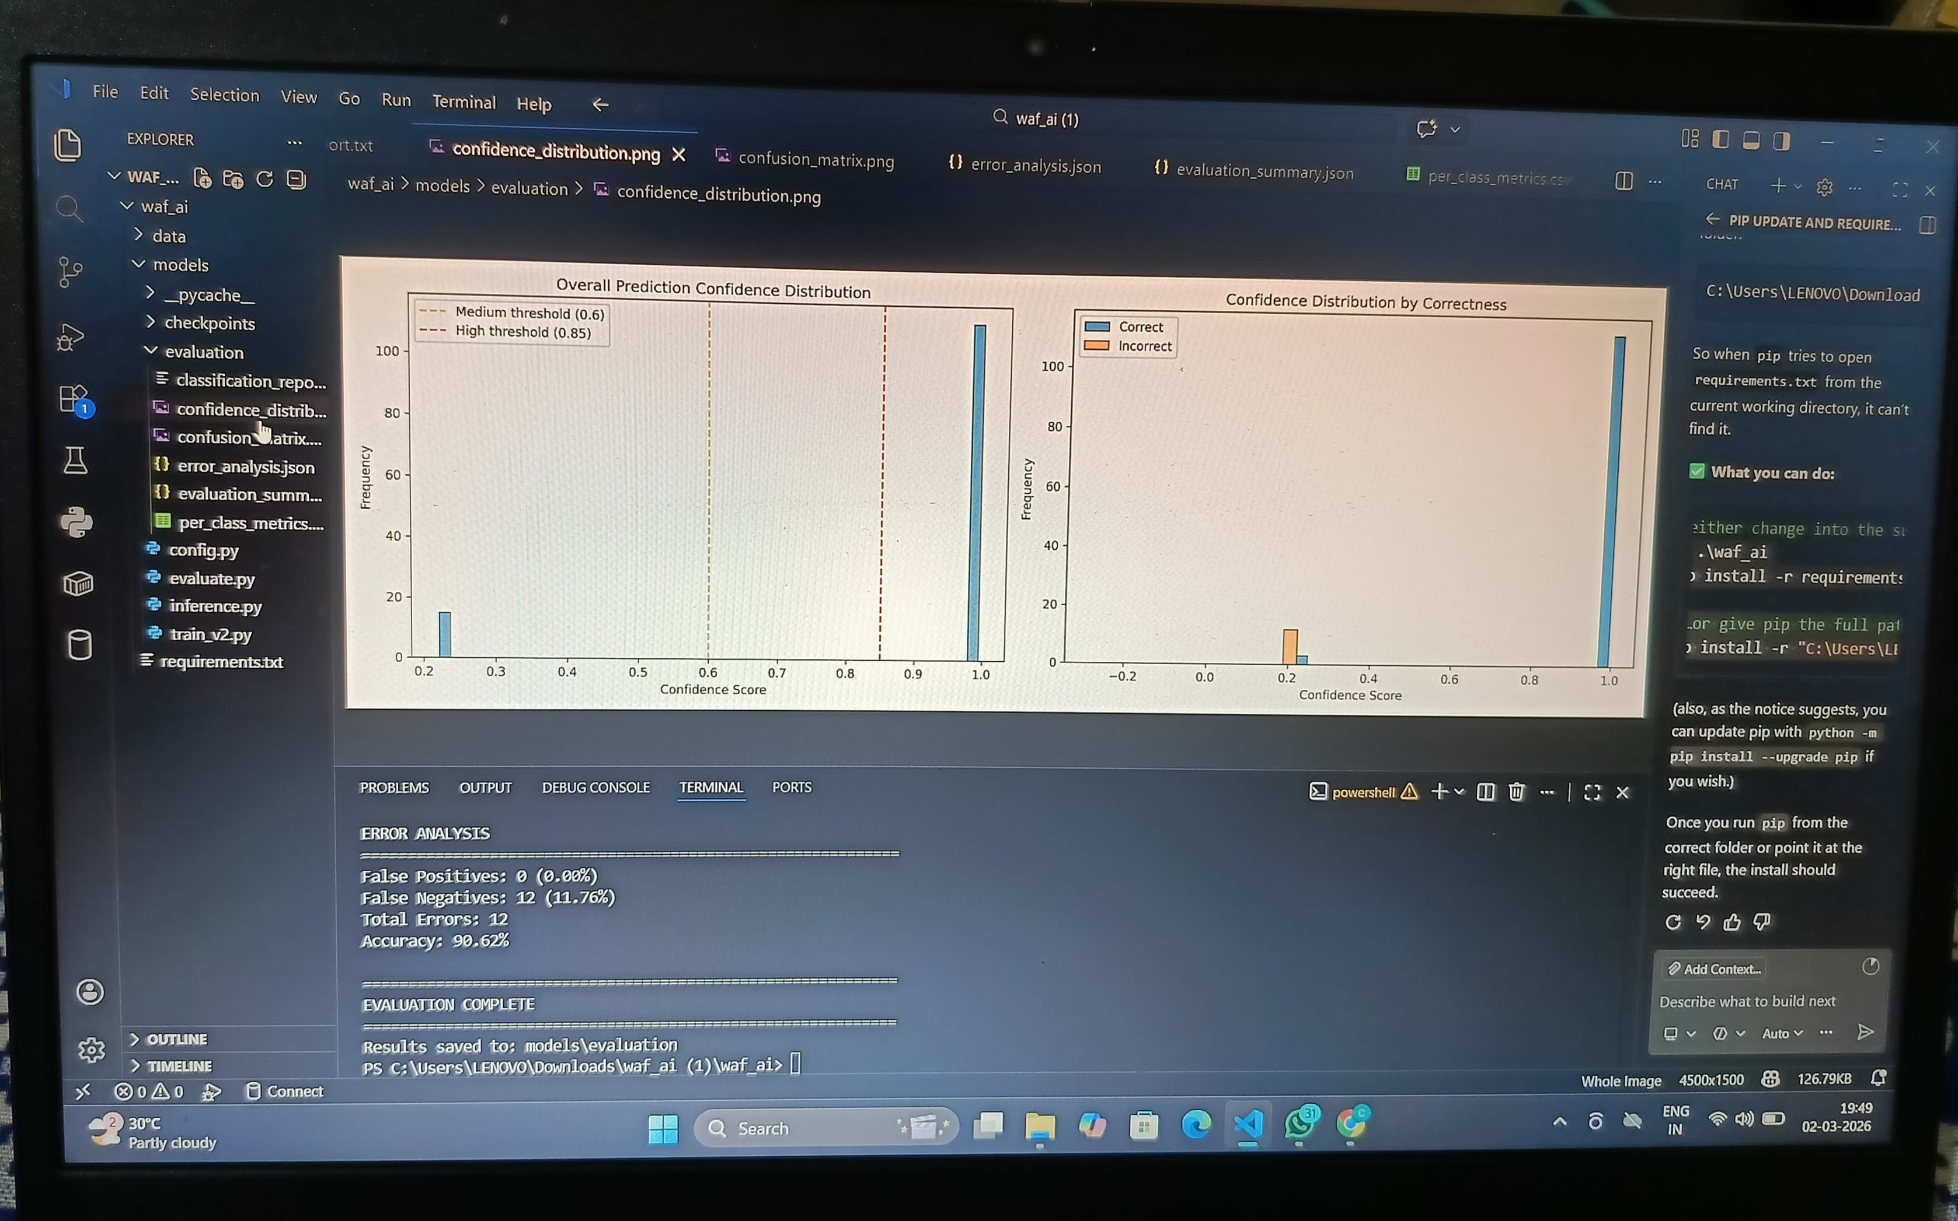
Training Results

Slide 19
Conclusion
Transformer-based WAF provides advanced threat detection using deep learning.
Captures context and patterns better than traditional rule-based systems.
Enables real-time and automated attack detection.
Reduces false positives and improves accuracy.
Supports continuous learning from new attack data.
Highly scalable and adaptable to evolving security threats.
Overall, ensures strong, intelligent, and future-ready web application security.

Slide 20
References
Vaswani et al., “Attention Is All You Need”, NeurIPS 2017
Devlin et al., “BERT: Pre-training of Deep Bidirectional Transformers”, NAACL 2019
Goodfellow et al., “Deep Learning”, MIT Press
OWASP Foundation, OWASP Top 10 Web Application Security Risks
Kim et al., Deep Learning-based Web Intrusion Detection Systems
OpenAI / Google Research papers on Transformer architectures
Research articles on AI-based Web Application Firewall (WAF) systems

Slide 21
Github Link
GitHub Link : https://github.com/varshthrss/CDV_14_WEB_Pipeline

Slide 22
Q&A

Slide 23
Thank you !!

